Slide 1
Production-readiness Concepts
Ishaan Malik

Slide 2
Production Ready API
An API built to reliably handle real-world traffic, security threats, and unexpected failures without crashing.

Slide 3
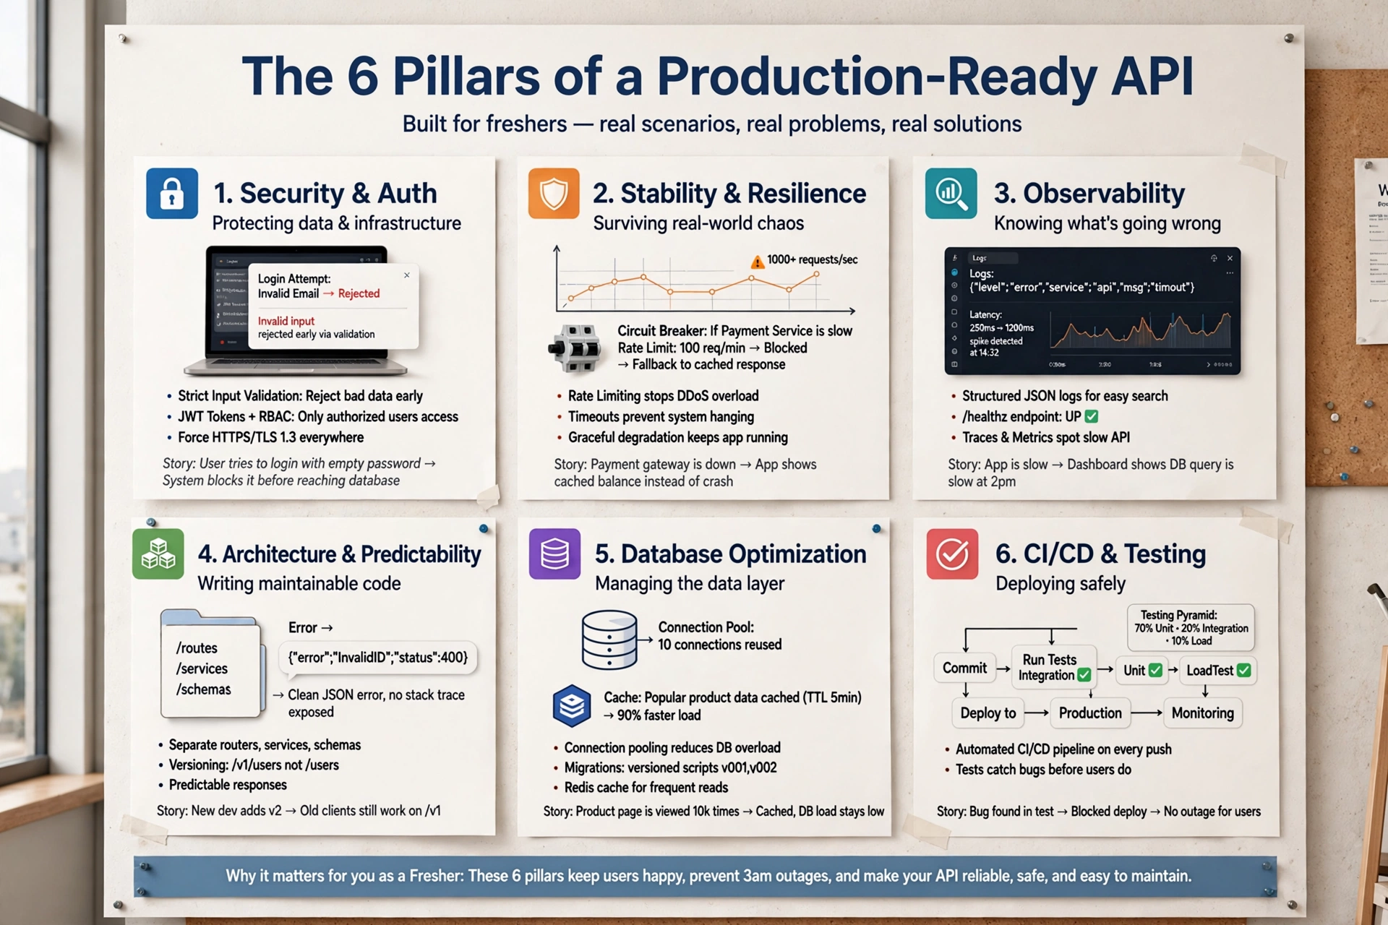

Slide 4
API Versioning
API versioning lets you change your API without breaking the apps that already use it.
You publish the new behavior as a new version (v2) and keep the old one (v1) running until clients have moved.

Slide 5
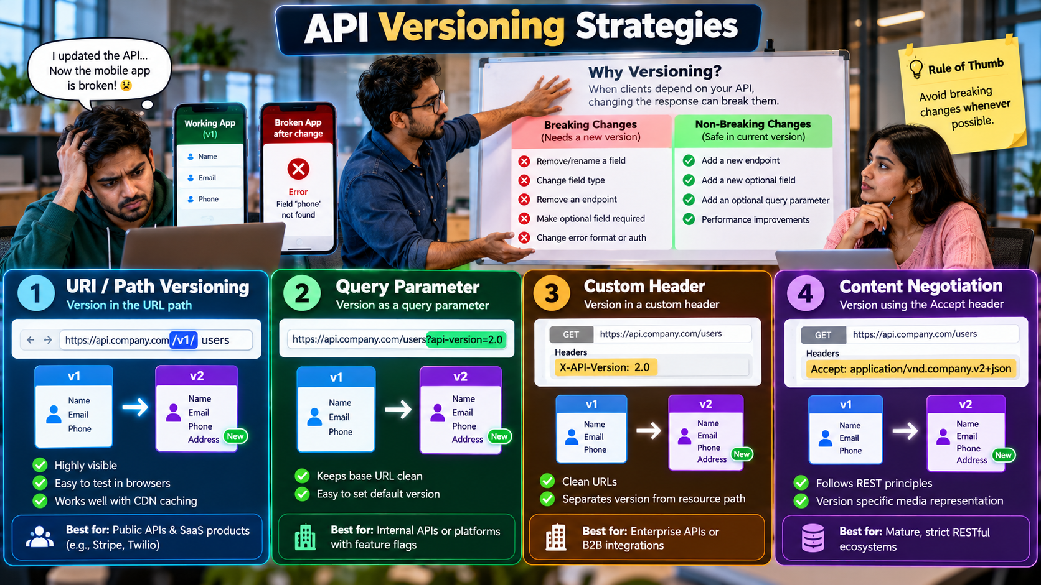

Slide 6
Response Caching and Rate Limiting
Response Caching and Rate Limiting are performance and security controls for web APIs.
Response caching and rate limiting have opposite goals.
Response caching makes your API faster by reusing answers it has already produced. Rate limiting protects your API by capping how many requests one caller can make.

Slide 7
Response caching
Response caching means storing a response and reusing it for later identical requests.
When many clients ask for the same unchanging data (for example, a product list), the server computes the answer once and reuses it, so the database isn't hit every time.

Slide 8
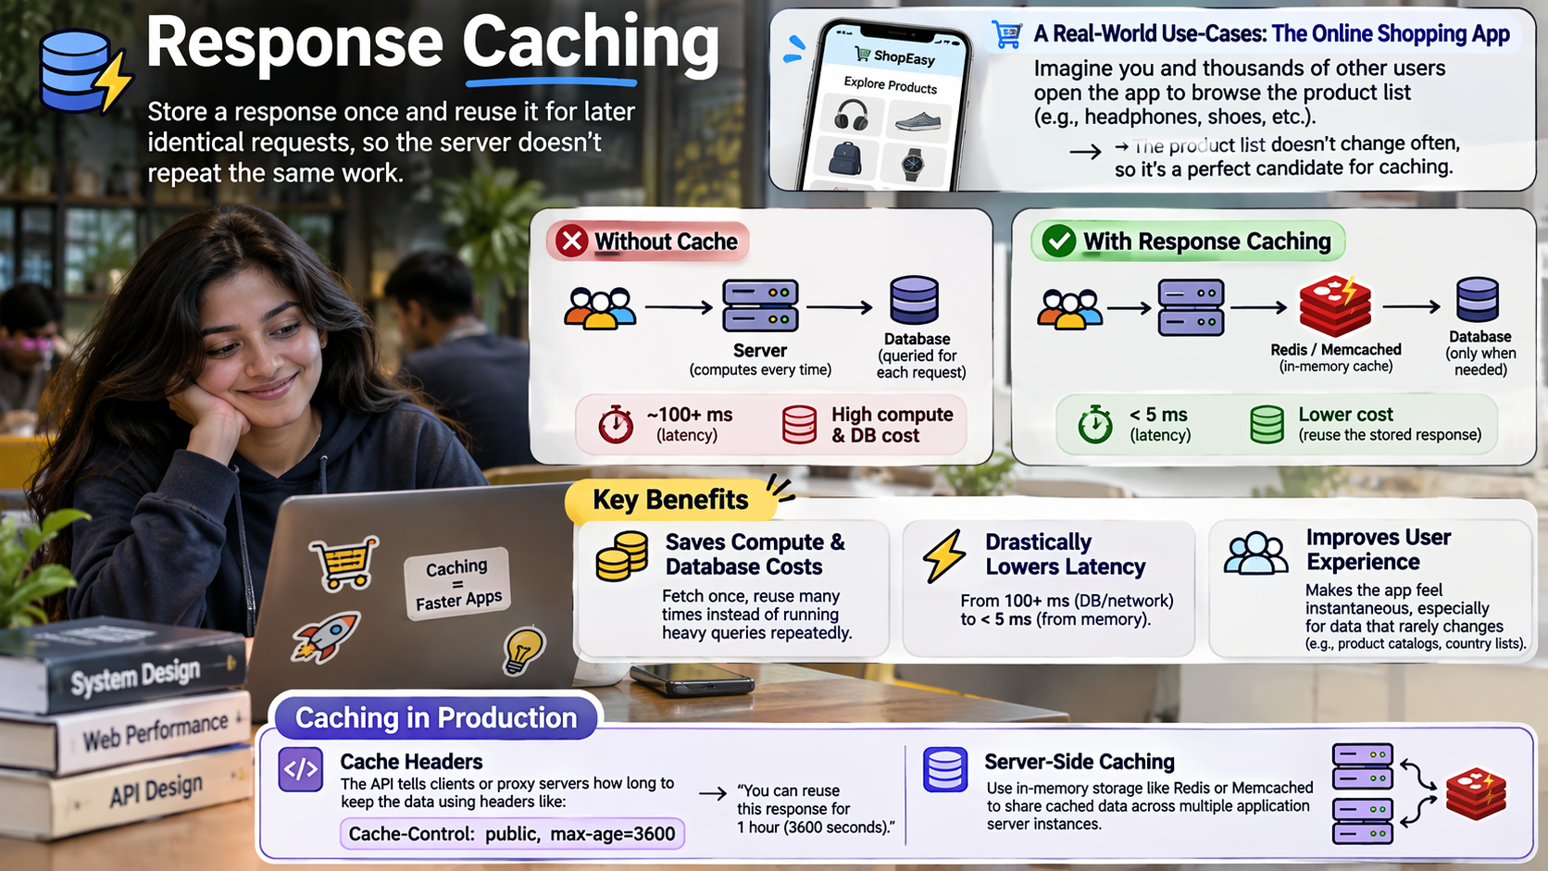

Slide 9
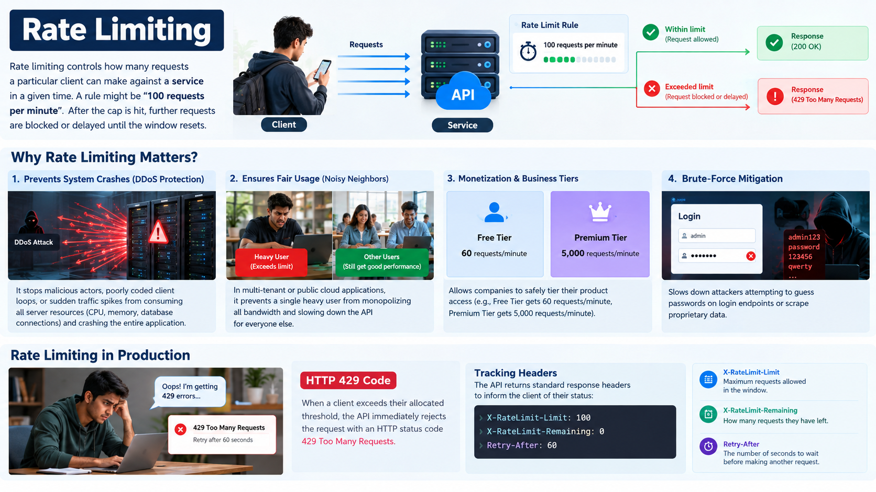

Slide 10
Health Checks
Health checks are small endpoints that tell tools and humans whether your API and its dependencies are working.
A health check is an HTTP endpoint that reports whether your app and its dependencies (database, cache, external APIs) are actually working.

Slide 11
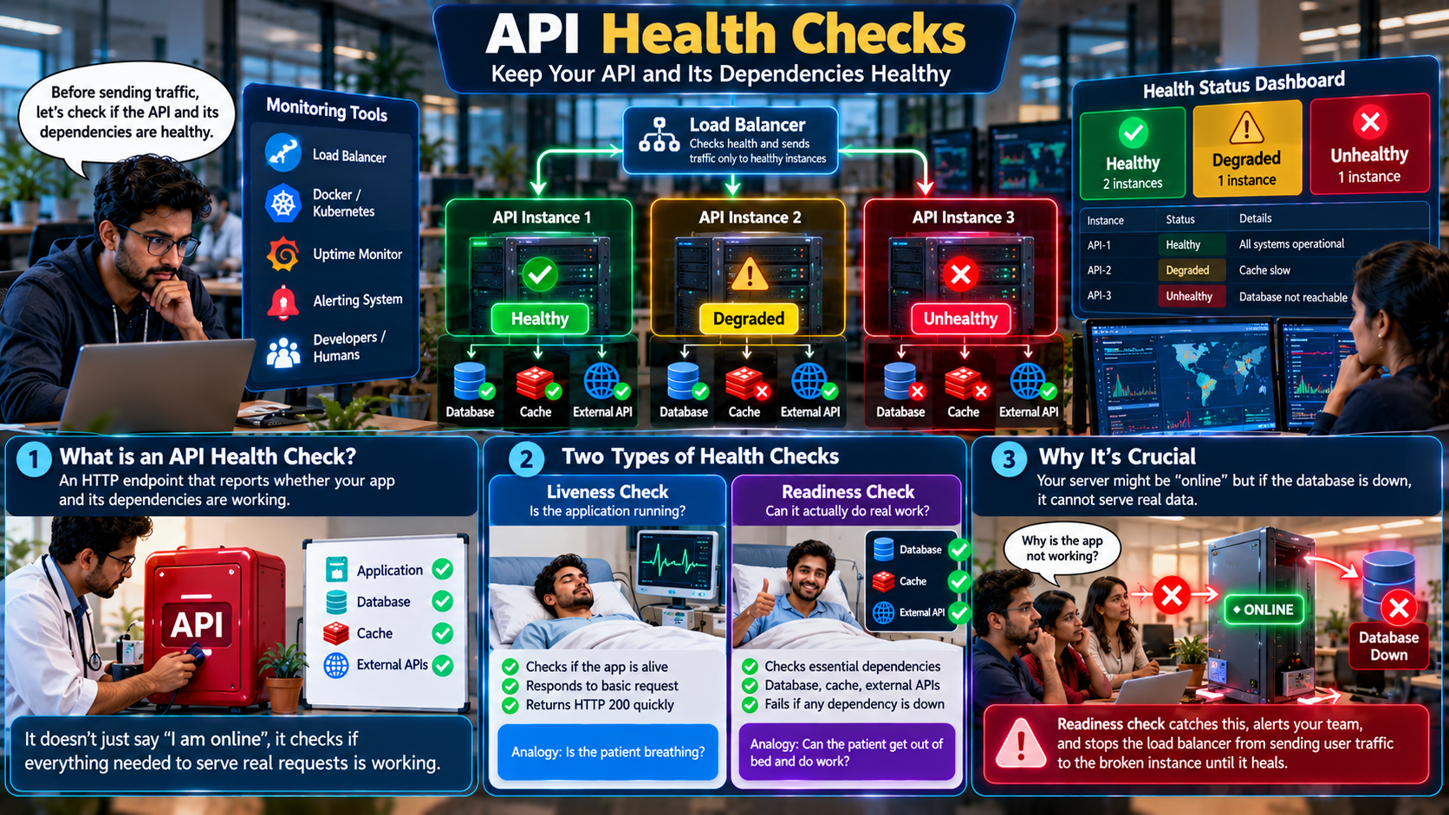

Slide 12
API Observability
Observability means you can understand what is going on inside your running API by looking at the data it emits.
In the old days of development, engineers relied on Monitoring (which just looks at basic charts like "CPU usage is at 90%").
Observability goes deeper—it provides internal visibility into your system by looking at three distinct data types, commonly called the Three Pillars of Observability:
  Metrics (The Dashboard Gauges)
  Logs (The Diary of Events)
  Traces (The Map of the Journey)

Slide 13
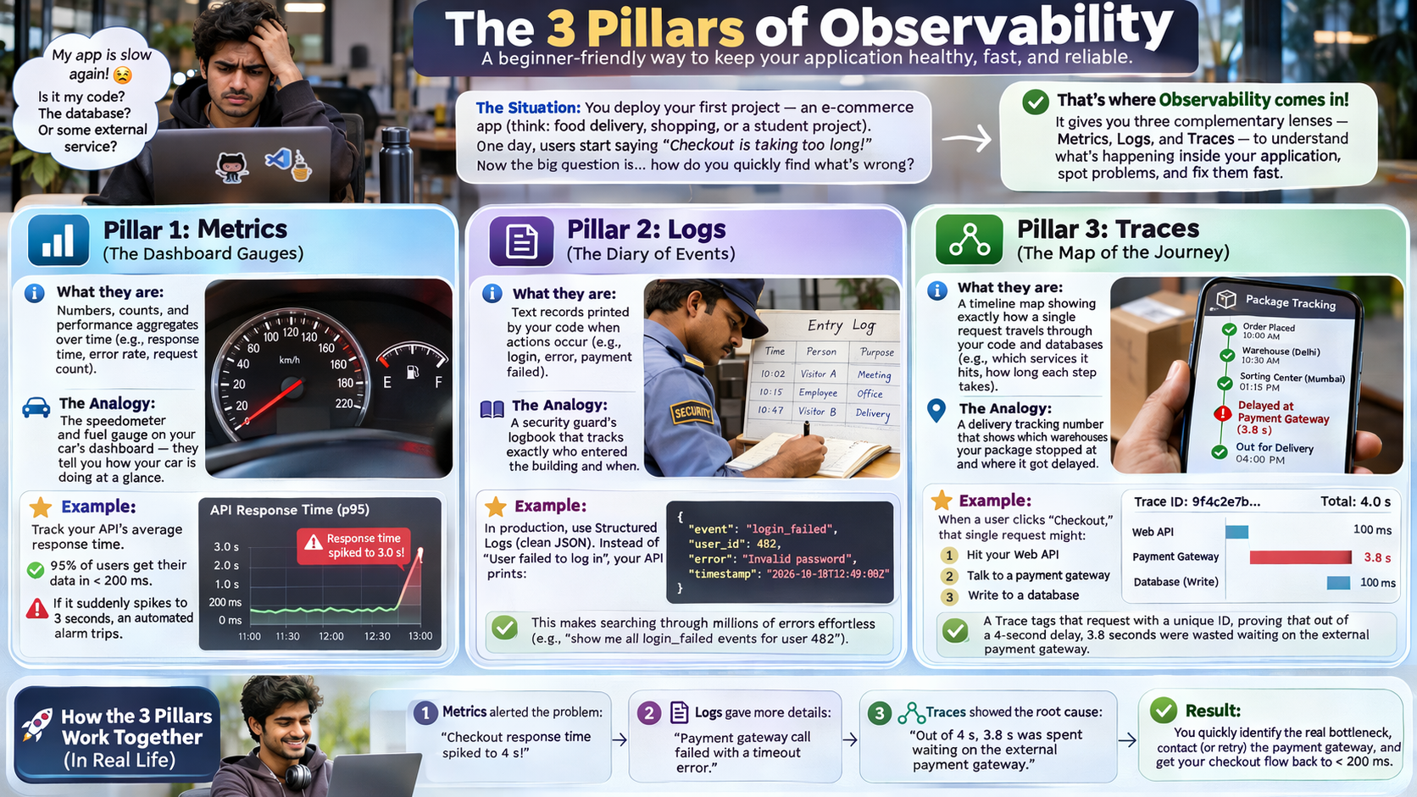

Slide 14
Practical Observability Ideas to Implement
The "Correlation ID" Middleware: Generate a unique, random string (like req-xyz-123) the absolute second an HTTP request touches your API.
  Attach this ID to every single log line, database query, and error generated by that request. If a user reports a bug, you can search that one ID and see the exact butterfly effect of what went wrong.
Automated Slack/Teams Alerts: Hook your global error handling framework into an observability platform (like Sentry, Datadog, or Honeycomb).
  If your API throws more than ten HTTP 500 Internal Server Errors within a 1-minute window, have it automatically ping your team's chat room with a direct link to the failing code line.

Slide 15
Quick Quiz
What is the primary architectural benefit of implementing edge or proxy-level response caching for read-heavy APIs?
It guarantees real-time consistency of transactional data across distributed database replicas.
It eliminates the need for database indexing by pre-computing all relational joins.
It significantly reduces backend compute load and network latency by serving immutable or semi-static responses closer to the client.
It enforces strict authorization checks at the network perimeter before authentication tokens are validated.
Answer: C

Slide 16
Quick Quiz
When designing a rate-limiting strategy using the Token Bucket algorithm for public API consumers, what is a key operational advantage over a fixed-window counter?
It allows for controlled bursts of traffic up to the bucket capacity while maintaining a defined average rate over time.
It completely eliminates the requirement for distributed state stores like Redis in multi-instance API deployments.
It prevents the HTTP 429 Too Many Requests status code from ever being returned to legitimate clients.
It automatically scales the backend microservice CPU resources based on incoming request volume.
Answer: A

Slide 17
Quick Quiz
Within the three pillars of observability (metrics, logs, and traces), what is the primary role of distributed tracing in a microservices architecture?
To aggregate historical CPU and memory utilization trends across physical infrastructure clusters.
To track the end-to-end lifecycle, timing, and propagation of a single request as it traverses multiple distinct services and network boundaries.
To store granular, unstructured text events emitted by application runtimes for audit compliance.
To replace unit tests by executing automated regression suites against live production endpoints.
Answer: B

Slide 18
Q&A
The End

